Slide 1
FINAL PROJECT FOR IVY
CUSTOMER LIFE TIME VALUE (CLV)
Prediction

Slide 2
Index
Overview
Business Approach
Business Strategies
Data Pre-processing
Model Building
Result with interpretation
Significance of Independent Variables
Conclusion and Business recommendation

Slide 3
Overview
Objective:
We are expected to create an analytical and modelling framework to predict the lifetime value of each customer based on the quantitative and qualitative features.
The lifetime value of a customer, or customer lifetime value (CLV), represents the total amount of money a customer is expected to spend in your business, or on your products, during their lifetime. Calculating the CLV for different customers helps in a number of ways

Slide 4
Business Approach
Acquire more customer
Retain more customer
Increase customer profitability

Slide 5
Customer life cycle
More Efficient Customer Retention
Better Cross / Up selling
PROFIT
More Efficient acquisition of new customers
Recovery of Potential Valuable Customers
PROFIT
Faster Termination of Less Valuable Customer
TIME
Acquisition
Retention
Termination

Slide 6
Business Strategies
More Efficient Customer Retention
Better Cross / Up selling
Do the Customer have high probability of cross-selling?
Do the Customer have high potential?
PROFIT
More Efficient acquisition of new customers
Recovery of Potential Valuable Customers
Do the Customer have low potential?
Do the new customer has same profile as valuable customer?
PROFIT
Faster Termination of Less Valuable Customer
TIME
Acquisition
Retention
Termination

Slide 7
Data pre-processing
Dataset was given with 9135 data points and 22 variables.
The missing values were replaced with mean/median of the respective variable.
Though there is no missing values in the dataset which we got to know from plot comparison.
Even the KNN Imputation was used to replace some of the NA values.
Using the Step AIC and VIF some of the variables are been removed.

Slide 8
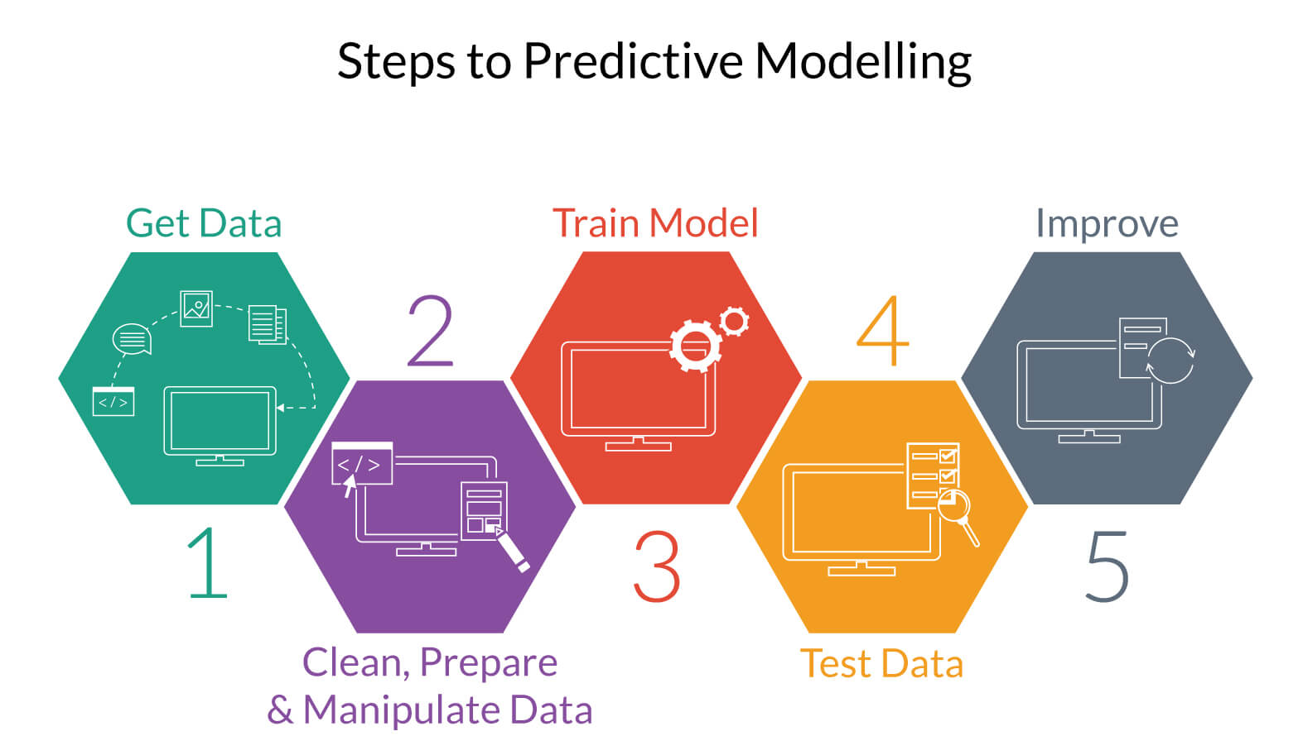
Model Building

Slide 9
Result with Interpretation
After performing the linear regression, the adjusted R2 was around 0.34 so the model is doing well over predicting the target variables.
Also as per F-statistic the P-value found was 2.2 e^-16 which also shows that the model is doing very well.
The less value of R2 means that data is spread widely across the linear regression line.
The model gave optimum values over the transformation of 1/x over other transformation.

Slide 10
Significance/ Business meanings of Variables
After doing Linear Regression Model we came to know that Coverage, Monthly Premium Auto, No of Policies and Renew Offer Type these variables are at 95% significant level, that means our CLV is more depending on these variables at 95% significant level.
People using extended coverage are impact fully inclined towards the lifetime coverages . Whereas premium users are having lesser lifetime coverage value than extended Coverage users
Employed people, retired people and people having medical leave have a better tendency to retain the lifetime coverage than unemployed people.
The customer who are using Luxury Car and Luxury Car SUV are more inclined to lifetime coverages rather than people who are using Sports Car and SUV.

Slide 11
Conclusion and Business recommendation
As the Customer who is using Four Door Car and Two Door car more inclined to coverages and even the Loss incurred by them is more.
After Clustering we can easily segregate the customers into 4 groups and they where clearly different with other groups.
Group 4 Customers are the most profitable customer in comparison with the customer life time value but the no. of customer count is less.
Even Group 3 Can be Bought in to Group 4 by giving offers to them and even new attracting policies.

